Slide 1
Household and Respondent Characteristics
Follow along on Twitter!
@NMEPNigeria #NigeriaMIS
@INS_cameroun #CameroonMIS #CamerounEIP

Slide 2
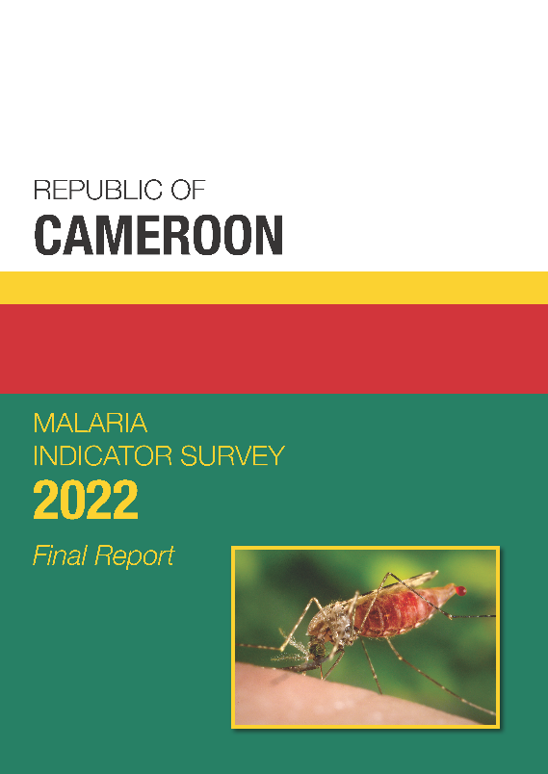
Household Characteristics
Water and sanitation
Electricity
Ownership of goods
Wealth
Respondent Characteristics
Education
Literacy
Find these data in Chapter 2 of the Final Report

Slide 3



Household Population
46% of Cameroon’s population is under age 15.
26% of households are headed by women.
Households have an average of 4.9 members.
Notes:
Nearly half of Cameroon’s population is under age 15. Over one quarter of households are headed by women. Households average about 5 members each.
From Tables 2.7 and 2.8
Pie chart comes from Table 2.7. Add the cells for <5, 5-9, and 10-14 from the final column in the table.
Household graphic comes from Table 2.8. Click on the grey house you want to change, choose Picture Format tab from top Menu, choose Crop. Manually adjust the width of the house until it’s close enough to the percent you’re looking for.
Person graphic comes from Table 2.8. Use same technique as above to adjust the graphic.

Slide 4

Drinking Water Service by Residence
Percent distribution of household population by drinking water service ladder
Indicators 1.4.1, 6.1.1
Figures ≠ 100% due to rounding.
Notes:
Three-quarters of household populations have at least basic service for drinking water.
Limited service = Drinking water from an improved source, provided round-trip collection time is >30 minutes or is unknown.
At least basic service = Drinking water from an improved source, provided either water is on the premises or round-trip collection time is <30 minutes. Includes safely managed drinking water.

Slide 5
Sanitation Service Ladder by Residence
Percent distribution of household population by type of sanitation service
Indicators 1.4.1, 6.2.1
Figures ≠ 100% due to rounding.
Notes:
Nearly half of the household population has access to at least basic sanitation services.
Note: Service ladder concept/definitions based on the WHO/UNICEF Joint Monitoring Programme for Water Supply, Sanitation, and Hygiene (JMP).
¹ Use of flush/pour flush toilet not to sewer, septic tank, or pit latrine, pit latrines without a slab/open pit, hanging toilets/latrines, or buckets
² Defined as use of improved facilities shared by 2 or more households
³ Defined as use of improved facilities that are not shared with other households. Includes safely managed sanitation service, which is not shown separately.
Table 2.4

Slide 6
Electricity by Residence
Indicator 7.1.1
Percent of household population with electricity:
Notes:
Overall, about 2 of 3 household population has access to electricity. Electricity is more common in urban areas (97% in Yaoundé and Douala and 80% in other urban areas) than in rural areas, where only 35% have access to electricity.
Table 2.6

Slide 7
Households with ICTs by Residence
Percent of households with a:
Notes:
Mobile phones are the most common asset owned by households (89%), both in urban (97% overall) and rural areas (80%).
Table 2.7

Slide 8
Households with a Means of Transportation by Residence
Percent of households with a(n):
Notes:
The most common means of transportation is the motorcycle or scooter (23%) followed by the bicycle (10%). Cars or trucks are more common in the urban areas (13% overall) than in rural areas (4%).
Table 2.7

Slide 9
Wealth Index
Wealth is determined by scoring households based on a set of characteristics including access to electricity and ownership of various consumer goods.
Households are then ranked from lowest to highest score.
The list is then separated into 5 equal pieces (or quintiles), each representing 20% of the population.
Those in the highest quintile (top 20%) may not be “wealthy” but they are of higher socioeconomic status than 80% of the population.

Slide 10
Wealth Index
 | Lowest | 2nd | Middle | 4th | Highest
Yaoundé/ Douala | 0% | <1% | 6% | 35% | 58%
Other urban | 4% | 13% | 32% | 32% | 20%
Rural | 39% | 33% | 19% | 6% | 4%
Far North (53%) has the highest proportion of households in the poorest quintile, while Douala (61%) has the highest proportion of households in the wealthiest quintile.

Slide 11
Household Characteristics
Water and sanitation
Electricity
Ownership of goods
Wealth
Respondent Characteristics
Education
Literacy
Find these data in Chapter 2 of the Final Report

Slide 12
Women’s Education
Percent distribution of women age 15-49
Figures ≠ 100% due to rounding.
Notes:
20% of women have no education. 25% of women have primary education, 44% have completed secondary education, and 12% have more than secondary education.
Table 2.14

Slide 13
Literacy
Percent of women age 15-49 who are literate
Notes:
Overall, 2 in 3 women are literate, while less than half of women in rural areas are literate.
Table 2.15

Slide 14
Exposure to Mass Media
Percent of women age 15-49 who are exposed to specific media on a weekly basis
Notes:
Nearly half of the women watch TV at least once a week, and nearly half of the women have no exposure to mass media.
Table 2.16

Slide 15
Internet Use
Indicator 17.8.1
Percent of women age 15-49 who:
Notes:
Almost half of the women have used the internet and slightly less than that have used the internet in the past 12 months.
Table 2.17

Slide 16
Key Findings
76% of the household population has access to at least basic drinking water service.
45% of the household population has access to at least basic sanitation service.
62% of the household population has electricity.
20% of women have never attended school.

